Slide 1


General Biology lab
Al-Karkh University for Science
Collage of Science
Microbiology Department
Dr. Rawa Abdul Redha Aziz
Ph.D Antibiotics/ Molecular biology
Laboratory Staff:
1. Lecturer Dr. Rawa Abdul Redha Aziz
2. L. assistant Sura Alaa Saud
3. L. assistant Gada Readh
Supervised by:
1. Prof. Munira Ch. Ismaeel
2. Ass. Prof. Israa AJ Ibrahim

Slide 2
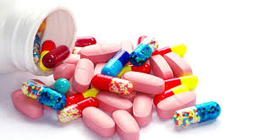
Lab 13: Microbial Control Agents

Slide 3
Bacteria and other microorganisms are found almost everywhere. Usually, microbial controls are used to avoid contamination of pure cultures, prevent infection, or treat existing diseases.
A microbicidal effect kills microorganisms. A microbistatic effect prevents the reproduction of microorganisms.
- Antiseptics are chemicals used on living tissues to inhibit the growth of microorganisms. Disinfectants are chemicals used on nonliving surfaces to inhibit the growth of microorganisms.

Slide 4
- Once an agent has been selected, it is important to evaluate it's effectiveness. In evaluating the effectiveness of antimicrobial agents, the concentration, length of contact, and whether it is lethal (-cidal) or inhibiting (-static) at that concentration and exposure are the important criteria.
- Many specialized tests can be used to determine specific effects of disinfectants, such as: dilution test, filter paper method and agar well diffusion method Procedure.

Slide 5
Procedure (agar well diffusion method):
1. Pour nutrient agar in petridishes.
2. Label a nutrient agar plate into six sections (1 to 6) on the bottom of the plate.
3. Aseptically swab the assigned culture onto a nutrient agar plate. Swab in three directions to ensure complete plate coverage.
4. Creat 6 wells using a 6mm cork borer in agar plate (Figure 1).
100 microlitre of disinfectants (differfnt dilution of chemicals) was dispensed in the dug well.
5. Incubated for 24 hr. at 37 0C and examined for growth inhibitory effects. During incubation, the chemical diffuses from the well containing the agent into the surrounding agar.
6. An effective agent will inhibit bacterial growth, and measurements can be made to quantify the size of the zones of inhibition around the well (Figure 2).
7. The relative effectiveness of a compound is determined by comparing the diameter of the zone of inhibition with values in a standard table.

Slide 6
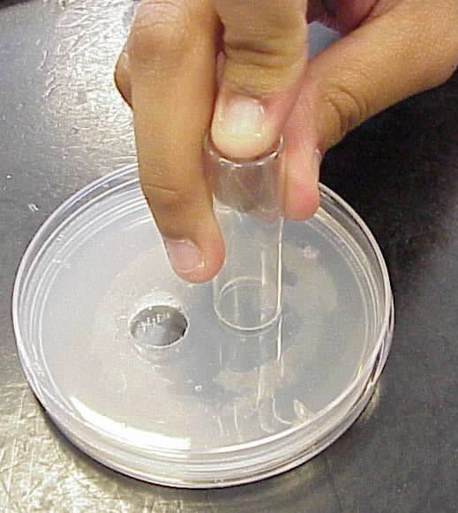
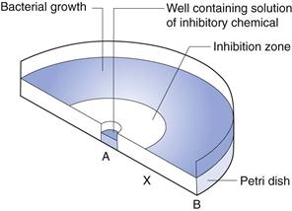
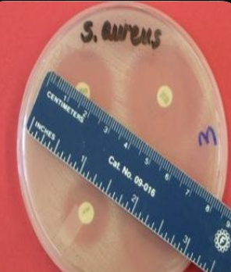
Figure 1: Creat 6 wells using a 6mm cork borer in agar plate
Figure 2a: How to read the results

Slide 7
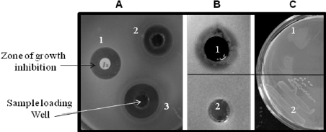
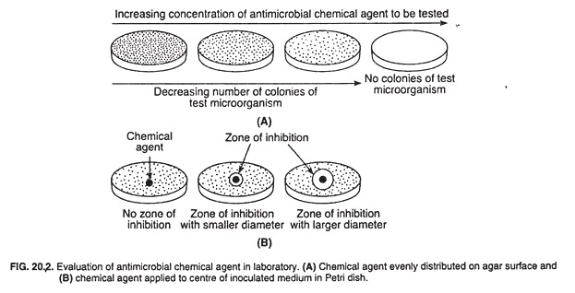
Figure 2 b: Read result

Slide 8
Lab Report
Name:
Group:
Name of experiment:
Materials:
Procedure:
Results:

